Slide 1


Computational Intelligence (TC2027)

Slide 2
Unit 5 – System Security (V)
General Attacks

Slide 3

General Attacks

Slide 4
Network Protocol Stacks
Application protocol
Application
Application
Transport
TCP protocol
Transport
Network
IP protocol
IP
IP protocol
Network
Link
Data Link
Network Access
Data Link
Link

Slide 5
Network Routing and Address Translation
Translation between IP addresses and MAC addresses
Address Resolution Protocol (ARP) for IPv4
Neighbor Discovery Protocol (NDP) for IPv6
Routing with IP addresses
TCP, UDP, IP for routing packets, connections
Border Gateway Protocol for routing table updates
Translation between IP addresses and domain names
Domain Name System (DNS)

Slide 6
Threats in Networking
Confidentiality
Packet sniffing
Integrity
Session hijacking
Availability
Denial of service attacks
Common
Address translation poisoning attacks
Routing attacks

Slide 7
Concrete Security Problems
ARP is not authenticated
APR spoofing (or ARP poisoning)
Network packets pass by untrusted hosts
Packet sniffing
TCP state can be easy to guess
TCP spoofing attack
Open access
Vulnerable to DoS attacks
DNS is not authenticated
DNS poisoning attacks

Slide 8
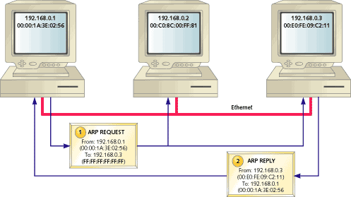
ARP Protocol

Slide 9
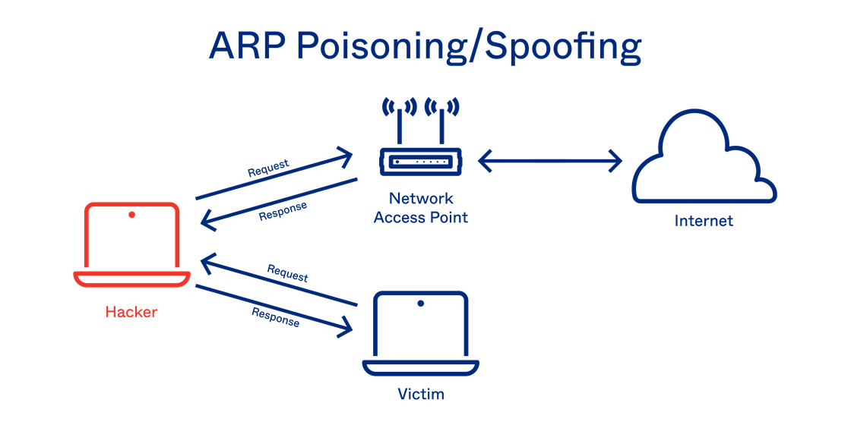
ARP Spoofing (ARP Poisoning)
Send fake or 'spoofed', ARP messages to an Ethernet LAN.
To have other machines associate IP addresses with the attacker’s MAC
Notes:
DHCP snooping is used when DHCP protocol is used to assign IP addresses to hosts on a LAN.

Slide 10
ARP Spoofing (ARP Poisoning)
Defenses
static ARP table
DHCP snooping (use access control to ensure that hosts only use the IP addresses assigned to them, and that only authorized DHCP servers are accessible).
detection: Arpwatch (sending email when updates occur),
Legitimate use
redirect a user to a registration page before allow usage of the network
Notes:
DHCP snooping is used when DHCP protocol is used to assign IP addresses to hosts on a LAN.

Slide 11
Arpwacth
arpwatch is a computer software tool for monitoring Address Resolution Protocol traffic on a computer network.
It generates a log of observed pairing of IP addresses with MAC addresses along with a timestamp when the pairing appeared on the network.
It also has the option of sending an email to an administrator when a pairing changes or is added.
Notes:
DHCP snooping is used when DHCP protocol is used to assign IP addresses to hosts on a LAN.

Slide 12
Packet Sniffing
Promiscuous Network Interface Card reads all packets
Read all unencrypted data (e.g., “ngrep”)
ftp, telnet send passwords in clear!
Eve
Network
Alice
Bob
Prevention: Encryption (IPSEC, TLS)

Slide 13
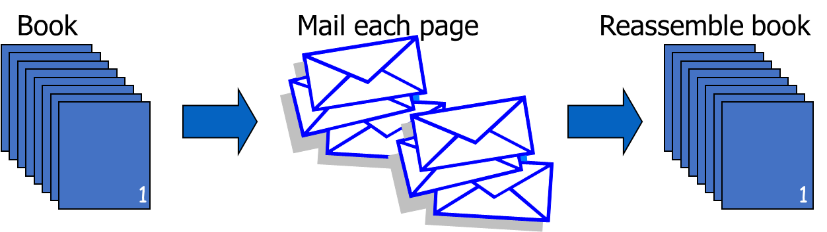
Transmission Control Protocol
Connection-oriented, preserves order
Sender
Break data into packets
Attach sequence numbers
Receiver
Acknowledge receipt; lost packets are resent
Reassemble packets in correct order

Slide 14
TCP sequence prediction attack
Predict the sequence number used to identify the packets in a TCP connection, and then counterfeit packets.
Adversary: do not have full control over the network, but can inject packets with fake source IP addresses
TCP sequence numbers are used for authenticating packets
Initial seq# needs high degree of unpredictability
If attacker knows initial seq # and amount of traffic sent, can estimate likely current values
Some implementations are vulnerable
Notes:
Why care about TCP sequence predictions? If the adversary controls the network, the adversary can read all sequence numbers.
Deals with more realistic adversary model:

Slide 15
Blind TCP Session Hijacking
Server A
A, B trusted connection
Send packets with predictable seq numbers
E impersonates B to A
Opens connection to A to get initial seq number
DoS B’s queue
Sends packets to A that resemble B’s transmission
E cannot receive, but may execute commands on A
E
B
Attack can be blocked if E is outside firewall.

Slide 16
Risks from Session Hijacking
Inject data into an unencrypted server-to-server traffic, such as an e-mail exchange, DNS zone transfers, etc.
Inject data into an unencrypted client-to-server traffic, such as ftp file downloads, http responses.
IP addresses often used for preliminary checks on firewalls or at the service level.
Hide origin of malicious attacks.
Carry out MITM attacks on weak cryptographic protocols.
often result in warnings to users that get ignored
Denial of service attacks, such as resetting the connection.

Slide 17
DoS vulnerability caused by session hijacking
Suppose attacker can guess seq. number for an existing connection:
Attacker can send Reset packet to close connection. Results in DoS.
Naively, success prob. is 1/2³² (32-bit seq. #’s).
Most systems allow for a large window of acceptable seq. #’s
Much higher success probability.
Attack is most effective against long lived connections (e.g. BGP).

Slide 18
Categories of Denial-of-service Attacks
 | Stopping services | Exhausting resources
Locally | Process killing Process crashing System reconfiguration | Spawning processes to fill the process table Filling up the whole file system Saturate comm bandwidth
Remotely | Malformed packets to crash buggy services | Packet floods (Smurf, SYN flood, DDoS, etc.)

Slide 19
SYN Flooding
C
S
SYN (seq=x)
Listening
Store data
Normal TCP Handshake
SYN ACK (ack=x+1 seq=y)
Wait
ACK (ack=y+1,seq=x+1)
Connected

Slide 20
SYN Flooding
C
S
SYN_{C1}
Listening
SYN_{C2}
Store data
SYN_{C3}
SYN_{C4}
SYN_{C5}

Slide 21
SYN Flooding
Attacker sends many connection requests
Spoofed source addresses
Victim allocates resources for each request
Connection requests exist until timeout
Old implementations have a small and fixed bound on half-open connections
Resources exhausted ⇒ requests rejected
No more effective than other channel capacity-based attack today

Slide 22
Smurf DoS Attack
1 ICMP Echo Req Src: Dos Target
Dest: brdct addr
3 ICMP Echo Reply Dest: Dos Target
gateway
DoS Target
DoS Source
Send ping request to broadcast addr (ICMP Echo Req)
Lots of responses:
Every host on target network generates a ping reply (ICMP Echo Reply) to victim
Ping reply stream can overload victim

Slide 23
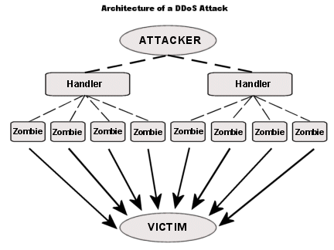
Distributed Denial of Service (DDoS)

Slide 24
DDoS Attack
Reflection
Find big sites with lots of resources, send packets with spoofed source address, response to victim
PING => PING response
SYN => SYN-ACK
Pulsing zombie floods
each zombie active briefly, then goes dormant;
zombies taking turns attacking
making tracing difficult

Slide 25
Unit 5 – System Security (V)
General Attacks

Slide 26
Computational Intelligence (TC2027)

